Slide 1
Module 5
Networking

Slide 2
Outline
MODULE 5 INTRODUCTION
Introduction to Networking
NETWORK COMPONENTS IN THE AWS CLOUD
Organizing AWS Cloud Resources
More Ways to Connect to the AWS Cloud
Subnets, Security Groups, and Network Access Control Lists
Amazon VPC Demo
Global Networking
CLOUD IN REAL LIFE
Global Architectures

Slide 3
Introduction to Networking

Slide 4
In this lesson, you will learn:
Describe what a virtual private cloud (VPC) is and what it does.
Describe what a subnet is and what it does.
Describe the difference between a public and private subnet.

Slide 5
Networking components
So far, you've learned about the AWS Cloud, AWS Regions, and Availability Zones.
Now you will review two more foundational networking components you will use in the AWS Cloud.
Amazon Virtual Private Cloud (Amazon VPC)
Subnet

Slide 6
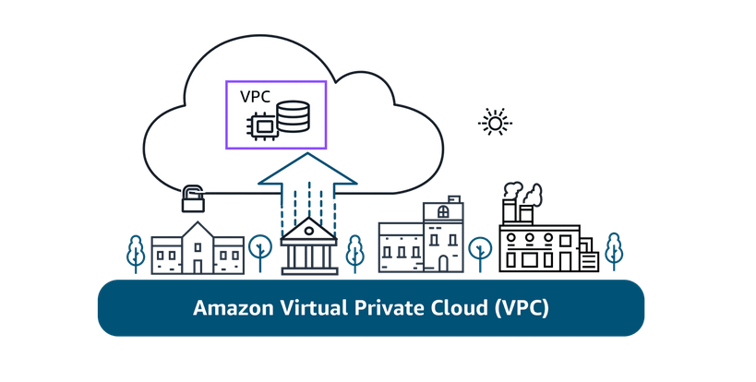
Amazon Virtual Private Cloud (Amazon VPC)
An Amazon VPC lets you provision a logically isolated section of the AWS Cloud where you can launch AWS resources in a virtual network that you define.

Slide 7
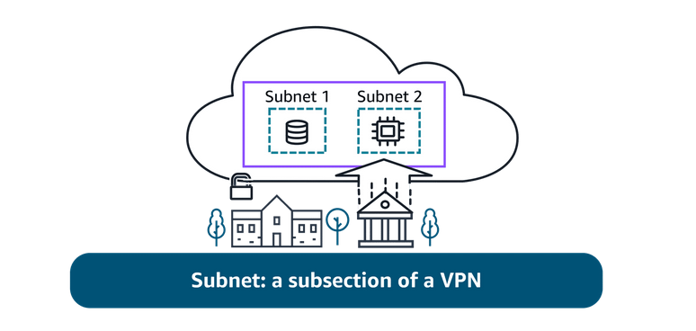
Subnet
Subnets are used to organize your resources and can be made publicly or privately accessible.
A private subnet is commonly used to contain resources like a database storing customer or transactional information.
A public subnet is commonly used for resources like a customer-facing website.

Slide 8
Understanding connections through diagrams
If you are new to IT or cloud computing, you might not have worked with architectural diagrams before.
A diagram is, simply put, a schematic or map of your network in the AWS Cloud.
It can provide a visual of how users or applications access services, resources, or data.
A picture is worth a thousand words. With a quick glance, you can see if the network was built for redundancy, security, and even scalability.
It can also serve as a blueprint so you don't forget important connections when building your solutions.

Slide 9
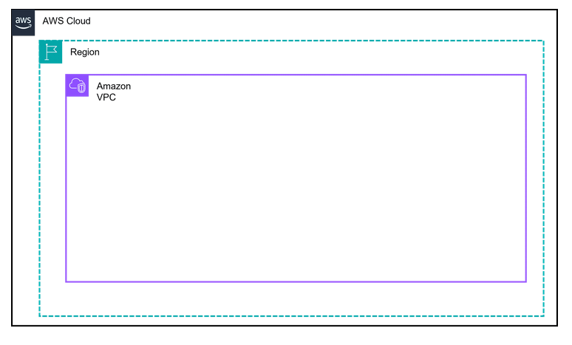
AWS Cloud, Regions, Amazon VPC, and AZs
AWS Cloud is the outermost box in most diagrams.
Region is the next box. AWS Regions are separate geographic areas. You choose your Region based on your users' geographic location for lower latency, compliance and data residency requirements, available services, and cost.

Slide 10
AWS Cloud, Regions, Amazon VPC, and AZs
Amazon VPC is a solid box, and it represents your isolated, logically segmented network within AWS. A VPC helps you to control your network resources and security.
Availability Zones are shown as separate boxes across a region. AZs consist of one or more discrete data centers, each with redundant power, networking, and connectivity, and housed in separate facilities. Using multiple AZs can protect your applications from the failure of a single location in the Region.

Slide 11
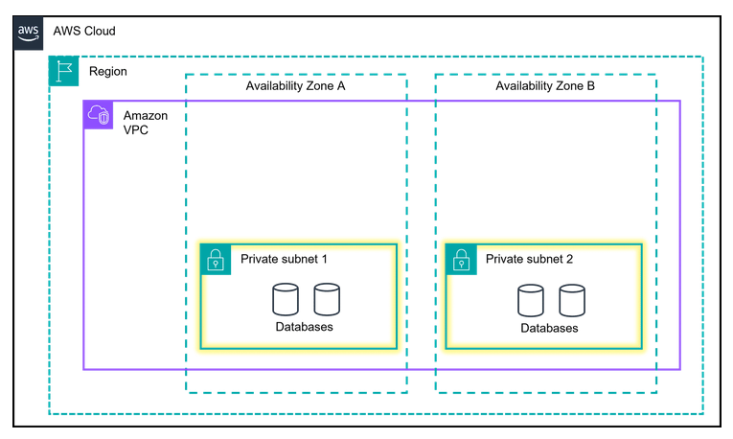
Private subnets
Subnets are essentially segments of your VPC, allowing you to divide your VPC into smaller, manageable sections. A subnet is a range of IP addresses in your VPC.
Private subnets are designed to isolate resources that shouldn't be directly exposed to the public internet. In diagrams, they are illustrated with solid boxes.

Slide 12
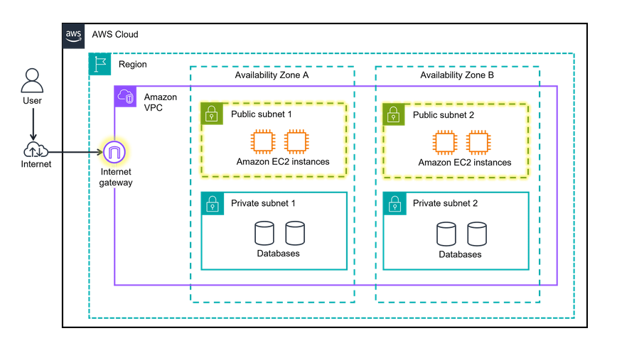
Public subnets
Public subnets are designed to provide direct internet access to resources placed inside them. To allow access, they are connected with an internet gateway. You will learn more about internet gateways in a later lesson. In diagrams, public subnets are drawn with dashed boxes.

Slide 13
Organizing AWS Cloud Resources

Slide 14
In this lesson, you will learn:
Define what a virtual private gateway is and what it does.
Identify the core components of a VPC.
Define an internet gateway and what it does.

Slide 15
Organizing resources in the AWS Cloud
Imagine the millions of customers who use AWS services. Also imagine the millions of resources that these customers have created, such as Amazon EC2 instances.
Without boundaries around all these resources, network traffic can flow between them unrestricted.
In the following section you will learn about two components of the AWS Cloud.
Amazon Virtual Private Cloud (VPC)
Gateways to connect your resources

Slide 16
Establishing boundaries around AWS resources
When organizing your resources in the AWS Cloud, you need to be able to group certain functions together and isolate them from the public, or make them available to the public.
You've been introduced to what Amazon VPCs do. Next, you will review the benefits.

Slide 17
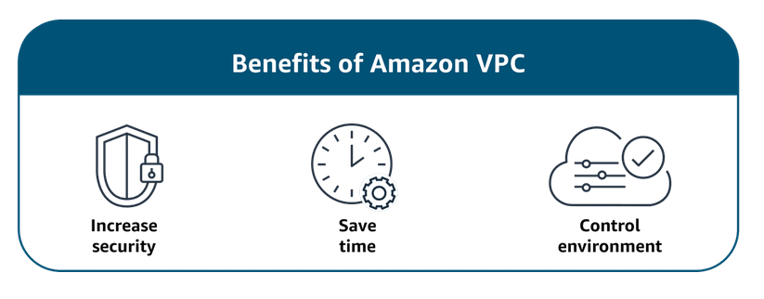
Benefits Amazon VPC
With Amazon VPC, you can provision an isolated section of the AWS Cloud.
In this isolated section, you can launch resources in a virtual network that you define.

Slide 18
Benefits Amazon VPC
It provides three main benefits.
It helps increase security because you can secure and monitor connections, screen traffic, and restrict instance access.
Amazon VPC gives you full control over your resource placement, connectivity, and security.
The convenience of using Amazon VPC means you will spend less time setting up, managing, and validating your virtual network when compared to on-premises network management.

Slide 19
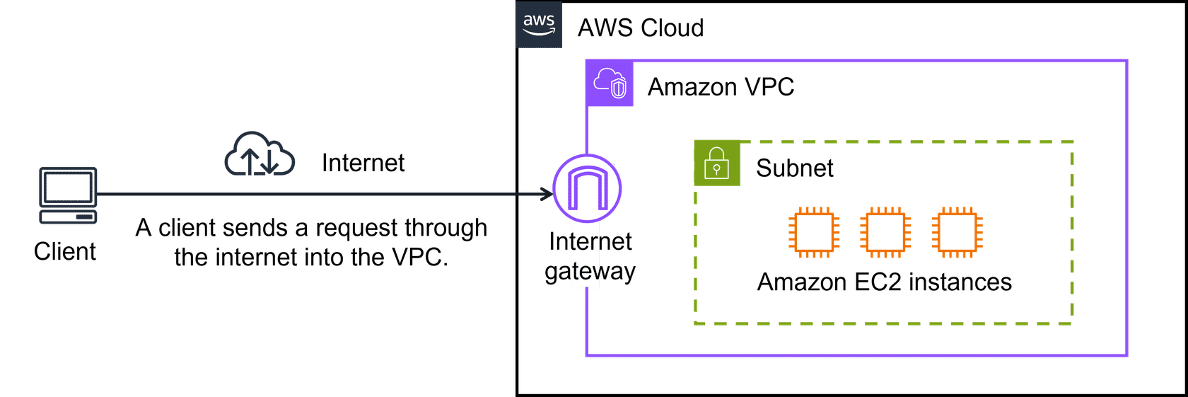
Connecting your resources with an internet gateway
To allow public traffic from the internet to access your VPC, you attach an internet gateway to the VPC.
An internet gateway is a connection between a VPC and the internet. You can think of an internet gateway as being similar to a doorway that customers use to enter the coffee shop.
Without an internet gateway, no one can access the resources within your VPC.

Slide 20
Virtual private gateways
What if you have a VPC that includes only private resources?
The following example shows how a virtual private gateway works.
You can think of the internet as the road between your home and the coffee shop.
It is open and accessible to anyone.
You want a way to protect the traffic you send on the internet from the public, internet service providers, and others who might be trying to track or intercept it.
This is where a virtual private network (VPN) connection comes in.

Slide 21
virtual private network (VPN)
VPN creates a connection that is more like a secure tunnel through the internet.
Using encryption, it hides and protects everything you send and receive from outside eyes.
A virtual private gateway is the component in the AWS Cloud that makes it possible for you to connect this protected traffic to enter the VPC.
With a VPN connection, your data travels privately and safely, hidden from others using the same route.

Slide 22
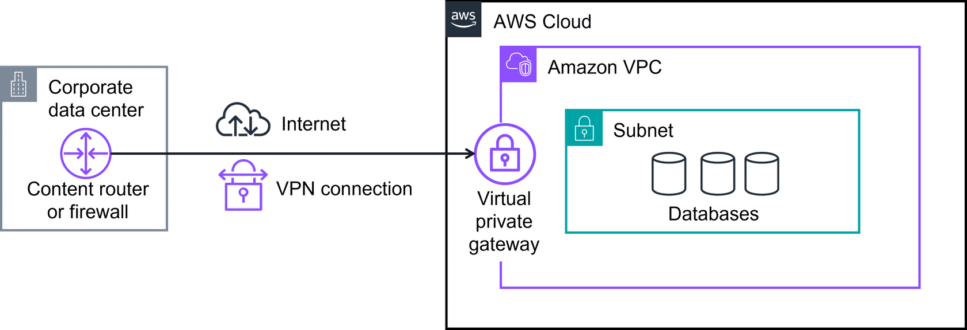
With a virtual private gateway, you can establish a VPN connection between your VPC and a private network, such as an on-premises data center or internal corporate network.
A virtual private gateway allows traffic into the VPC only if it is coming from an approved network.

Slide 23
Several of the preceding networking components have similar abbreviations and are often confused.
These components are core building blocks that you'll use in many AWS Cloud solutions.
Amazon Virtual Private Cloud Amazon VPC is used to establish boundaries around your AWS resources.
Virtual private gateway A virtual private gateway allows protected internet traffic to enter into the VPC.
Virtual private network A VPN encrypts your internet traffic, helping protect it from anyone who might try to intercept or monitor it.

Slide 24
More Ways to Connect to the AWS Cloud

Slide 25
In this lesson, you will learn:
Describe AWS Client VPN and when to use it.
Describe AWS Site-to-Site VPN and when to use it.
Describe AWS PrivateLink and when to use it.
Describe AWS Direct Connect and when to use it.
explore more hybrid cloud connections with the AWS Cloud. Specifically, you'll learn more ways to connect your clients, datacenters, and sites to the AWS Cloud.

Slide 26
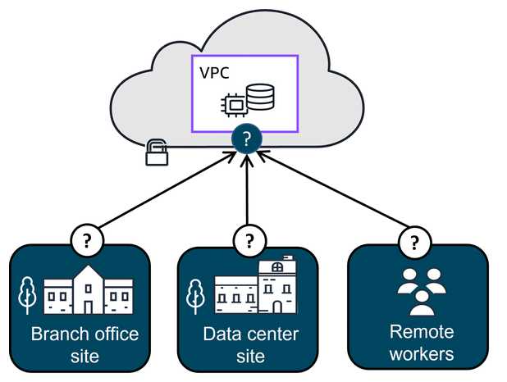
Connecting to the AWS Cloud
With so many different types of networks, on-premises datacenters, and remote workers, companies need a wide range of ways to connect to the AWS Cloud.
In the following section, you will learn four ways to connect to the AWS Cloud:
AWS Client VPN
AWS Site-to-Site VPN
AWS PrivateLink
AWS Direct Connect

Slide 27
Securely connect a remote workforce to AWS Cloud resources
Imagine a company with a recent acquisition needing to securely connect their new remote workforce to their AWS Cloud resources.
Even the largest companies with worldwide remote workers can quickly scale up and connect to the AWS Cloud.
That's where AWS Client VPN can help.

Slide 28
AWS Client VPN
AWS Client VPN is a networking service you can use to connect your remote workers and on-premises networks to the cloud.
It is a fully managed, elastic VPN service that automatically scales up or down based on user demand.
Because it is a cloud VPN solution, you don’t need to install and manage hardware or try to estimate how many remote users to support at one time.
Benefits:
AWS Client VPN provides advanced authentication, remote access.
It is elastic and fully managed.
Use case: It can be used to quickly scale remote-worker access.

Slide 29
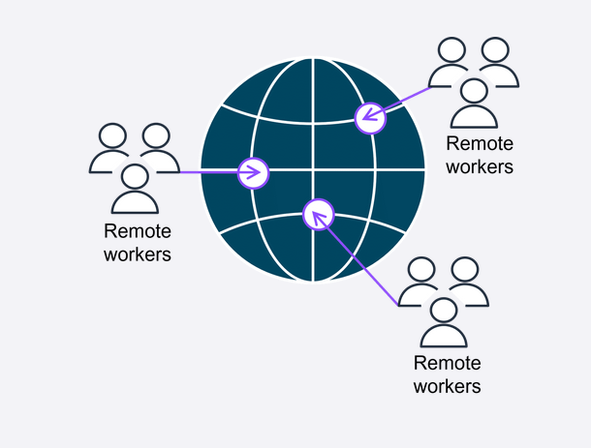
AWS Client VPN
Client VPN, a managed VPN service, provides secure access to AWS resources and on-premises networks from anywhere.
It uses an OpenVPN-based client, and it works with global Regions by using the AWS global network.

Slide 30
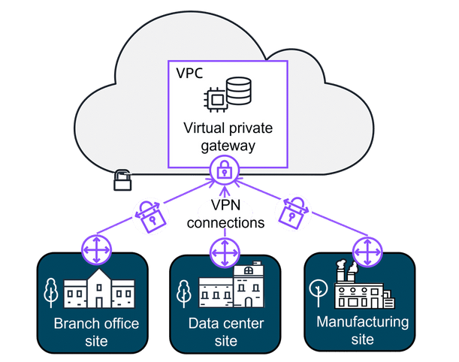
Securely connect sites to other sites
Some companies might want to establish secure, encrypted connections between their on-premises networks like data centers or branch offices and their resources in their Amazon VPC.
That's where Site-to-Site VPN can help.

Slide 31
AWS Site-to-Site VPN
Site-to-Site VPN creates a secure connection between your data center or branch offices and your AWS Cloud resources.
Benefits:
Site-to-Site VPN provides high availability, secure and private sessions, and accelerates applications.
Use cases:
It can be used for application migration and secure communication between remote locations.

Slide 32
Securely connect resources, even in other VPCs
Other companies sometimes need the flexibility to privately connect to resources in other cloud providers as though they were in their own VPC.
They need a way to communicate with these resources and don't want the hassle of setting up gateways or site-to-site VPNs.
That's where AWS PrivateLink can help.

Slide 33
AWS PrivateLink
AWS PrivateLink is a highly available, scalable technology that you can use to privately connect your VPC to services and resources as if they were in your VPC.
You do not need to use an internet gateway, NAT device, public IP address, Direct Connect connection, or AWS Site-to-Site VPN connection to allow communication with AWS services or resources from your private subnets.
Instead, you control the specific API endpoints, sites, services, and resources that are reachable from your VPC.
Benefits:
AWS PrivateLink helps you secure your traffic and connect with simplified management rules.
Use case:
It is used for connecting your clients in your VPC to resources, other VPCs, and endpoints.

Slide 34
How AWS PrivateLink Works
Service provider (could be AWS or a third party) creates a VPC endpoint service.
Service consumer (you) creates a VPC interface endpoint inside your own VPC, which appears like an elastic network interface (ENI) with a private IP.
Your applications connect to this endpoint using that private IP or a DNS name — AWS routes the traffic privately to the service provider.

Slide 35
But !
Even though the preceding connections are highly available and scalable, traffic jams are possible because you’re using the same connection as other clients.
That's why for some use cases, you might need a dedicated private connection with a lot of bandwidth.

Slide 36
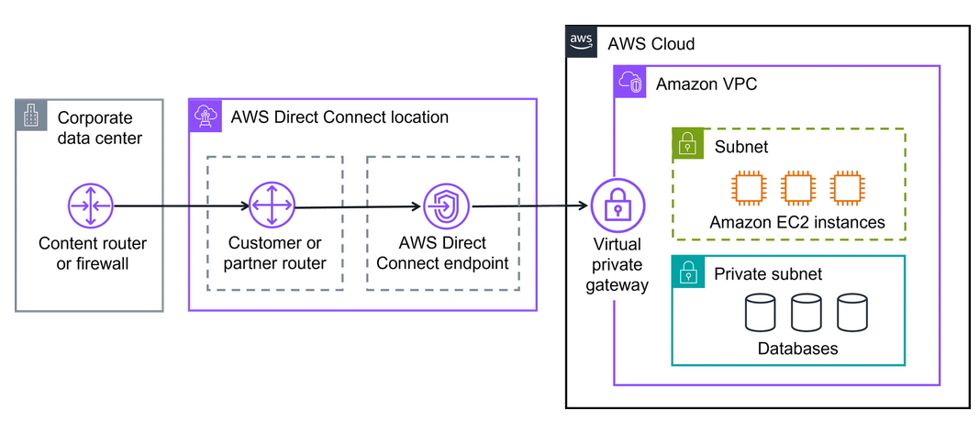
Dedicated private connections for increased bandwidth
AWS Direct Connect
Direct Connect is a service that makes it possible for you to establish a dedicated private connection between your network and VPC in the AWS Cloud.
Benefits:
AWS Direct Connect reduces network costs and increases amount of bandwidth.

Slide 37
AWS Direct Connect Use Cases
Latency-sensitive applications
Direct Connect bypasses the internet and provides a consistent, low-latency network experience.
This makes it ideal for applications like video streaming and other real-time applications that require high performance.
Large-scale data migration or transfer
Direct Connect helps ensure smooth and reliable data transfers at massive scale for real-time analysis, rapid data backup, or broadcast media processing.
Hybrid cloud architectures
You can use Direct Connect to link your AWS and on-premises networks to build applications that span environments without compromising performance.

Slide 38
Additional gateway services
There are several different types of gateways you can use to connect your AWS resources.
Depending on your needs, you might want to learn more about what they are used for and where to go to learn more.
AWS Transit Gateway:
Is used to connect your Amazon VPCs and on-premises networks through a central hub. As your cloud infrastructure expands globally, inter-Region peering connects transit gateways together using the AWS Global Infrastructure.
To learn more, refer to AWS Transit Gateways.

Slide 39
What is (TGW)
A fully managed AWS service that acts as a hub for network connectivity.
Works like a “cloud backbone” — you connect each network once to the Transit Gateway, and it can communicate with all the others through it.
How it works
You create a Transit Gateway in AWS.
You attach:
VPCs (via VPC attachments)
On-premises networks (via Site-to-Site VPN or Direct Connect)
Other AWS accounts (via Resource Access Manager)
TGW routes traffic between these attachments based on your route tables.

Slide 40
Network address translation (NAT) gateway:
Is a NAT service. You can use a NAT gateway so that instances in a private subnet can connect to services outside your VPC but external services can't initiate a connection with those instances. To learn more, refer to NAT gateway
Amazon API Gateway:
You learned about Application Programming Interface (API)s earlier.
Quick refresher, an API defines how different software systems can interact and communicate with each other.
The Amazon API Gateway is an AWS service for creating, publishing, maintaining, monitoring, and securing APIs at any scale. To learn more, refer to Amazon API Gateway

Slide 41
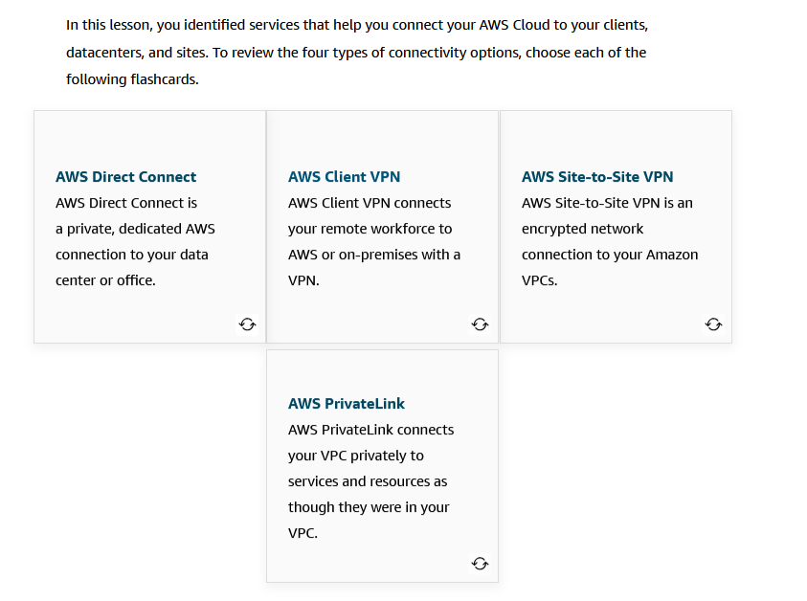
Connect to AWS cloud

Slide 42
Subnets, Security Groups, and Network Access Control Lists

Slide 43
In this lesson, you will learn:
Describe how network traffic works in a VPC.
Describe how security groups work (stateful).
Describe how network access control lists (network ACLs) work (stateless).
Describe who is responsible for securing subnets with security groups and network ACLs according to the AWS Shared Responsibility Model.

Slide 44
Intro
Now that you know the basic components of a network, you'll want to start thinking about security.
As you get started, you will notice there are many different choices to secure your resources in the AWS Cloud.
Two very powerful and flexible ways to control network traffic in your VPC are security groups and network access control lists, or network ACLs.
In this lesson, you will learn about defining the rules for your security groups and network ACLs, including how they work.
Using these two hardworking security components in your network design will help you to meet your specific application requirements, while also helping to ensure basic network security.

Slide 45
Subnets re-call
A section of a VPC for grouping resources based on security or operational needs
A subnet is a section of a VPC in which you can group resources based on security or operational needs. Subnets can be public or private.
Public subnets contain resources that need to be accessible by the public, such as an online store’s website.
Private subnets contain resources that should be accessible only through your private network, such as a database that contains customers’ personal information and order histories.
In a VPC, you can define rules to allow resources in different subnets to communicate with each other.
For example, you might have an application that uses Amazon EC2 instances in a public subnet communicating with databases that are located in a private subnet.

Slide 46
Network traffic in a VPC
The movement of data packets traveling across a network
When a customer requests data from an application hosted in the AWS Cloud, this request is sent as a packet.
A packet is a unit of data sent over the internet or a network.
It enters into a VPC through an internet gateway.
Before a packet can enter into a subnet or exit from a subnet, it will run into several checks for permissions, one being a network ACL associated with the subnet the packet is being routed to.
The permissions defined by the network ACLs indicate what is allowed or denied.
It is based on who sent the packet and how the packet is trying to communicate with the resources in a subnet.
The VPC component that checks packet permissions for subnets is a network ACL.

Slide 47
Network ACLs
Virtual firewall controlling traffic
A network ACL is a virtual firewall that controls inbound and outbound traffic at the subnet level.
For example, imagine that you are at the airport.
Travelers are trying to enter into a different country.
You can think of the travelers as packets and the passport control officer as a network ACL.
The passport control officer checks travelers’ credentials when they are both entering and exiting the country.
This is similar to how a network ACL checks permissions every time a packet travels across a subnet boundary.

Slide 48
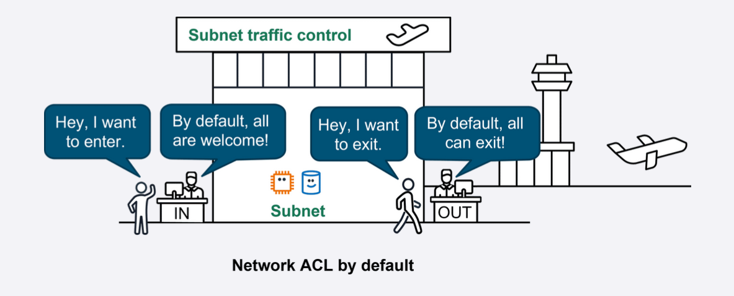
Network ACLs
Each AWS account includes a default network ACL.
When configuring your VPC, you can use your account’s default network ACL or create custom network ACLs.
By default, your account’s default network ACL allows all inbound and outbound traffic, but you can modify it by adding your own rules.

Slide 49
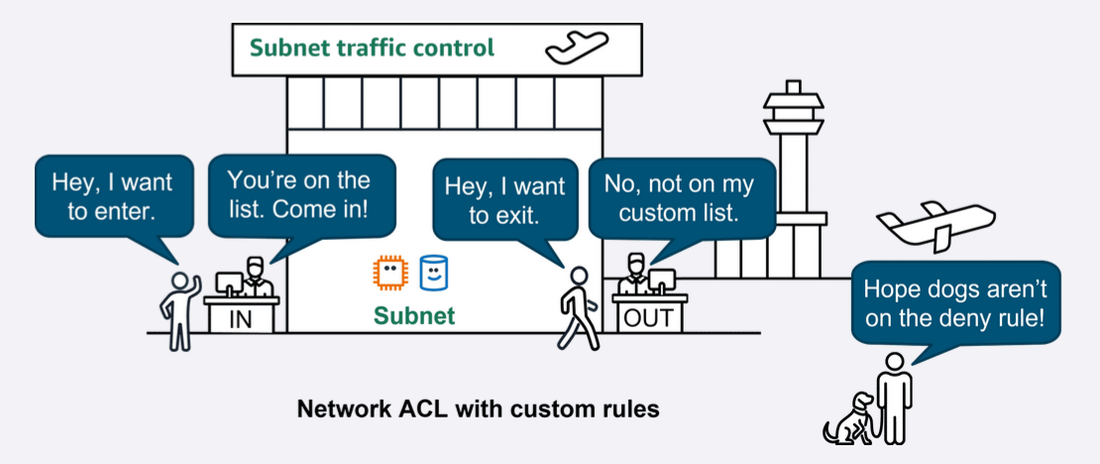
Network ACLs
For custom network ACLs, all inbound and outbound traffic is denied until you add rules to specify which traffic to allow.
Additionally, all network ACLs have an explicit deny rule.
This rule makes sure that if a packet doesn’t match any of the other rules on the list, the packet is denied.

Slide 50
Stateless packet filtering
Network ACLs perform stateless packet filtering.
They remember nothing and check packets that cross the subnet border each way: inbound and outbound.
Recall the previous example of a traveler who wants to enter into a different country.
This is similar to sending a request out from an Amazon EC2 instance and to the internet.

Slide 51
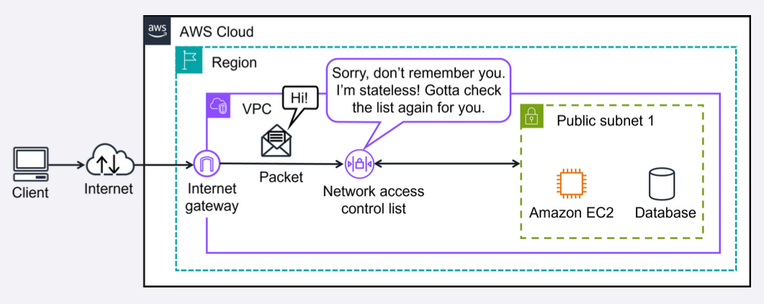
Stateless packet filtering
When a packet response for that request comes back to the subnet, the network ACL does not remember your previous request.
The network ACL checks the packet response against its list of rules to determine whether to allow or deny.

Slide 52
Security groups
Control inbound and outbound traffic at the resource level
After a packet has entered a subnet, it must have its permissions evaluated for resources within the subnet, such as Amazon EC2 instances. A
security group is the VPC component that checks packet permissions for an Amazon EC2 instance.
It is a virtual firewall that controls inbound and outbound traffic for specific AWS resources, like Amazon EC2 instances.
By default, a security group denies all inbound traffic and allows all outbound traffic.
For this example, suppose that you are at an apartment building with a door attendant who greets guests at the door. You can think of the guests as packets and the door attendant as a security group. With the default settings, the security groups won't let anyone in and allows all outbound traffic out.

Slide 53
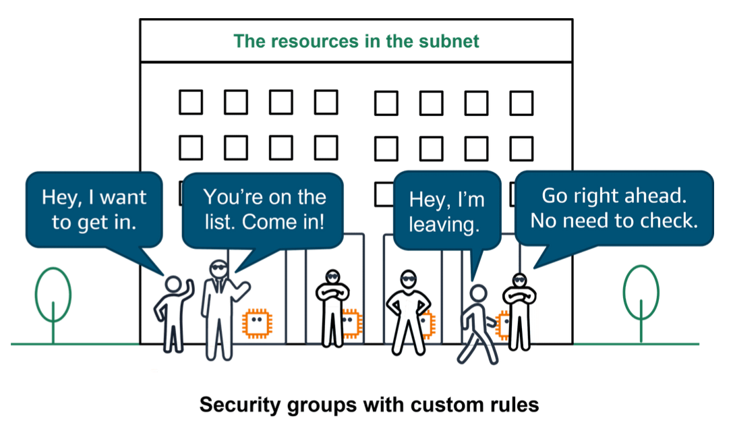
Security groups
With security groups, you can add custom rules to configure which traffic should be allowed.
Any other traffic would then be denied.
For example, custom rules can be given separately for inbound and outbound traffic. As guests arrive, the door attendant checks a list to makes sure they can enter the building. However, the door attendant does not check the list again when guests are exiting the building.

Slide 54
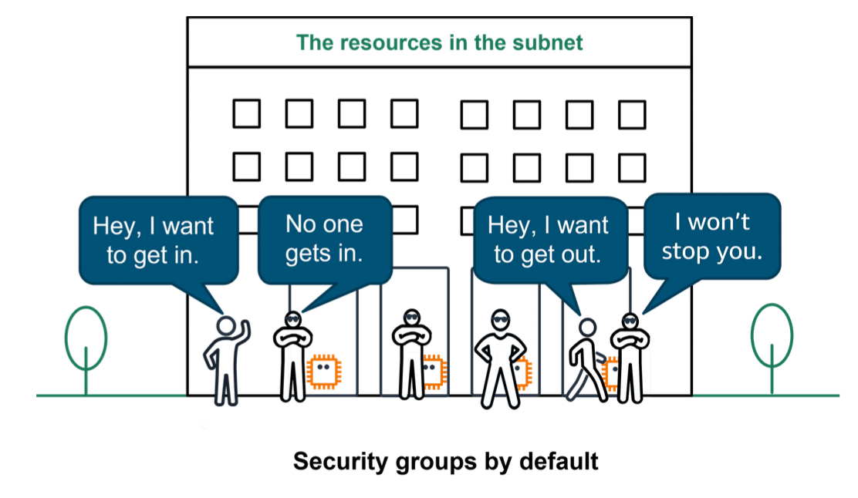
Note: If you have multiple Amazon EC2 instances within the same VPC, you can associate them with the same security group or use different security groups for each instance.

Slide 55
Stateful packet filtering
Security groups perform stateful packet filtering. They remember previous decisions made for incoming packets.
Consider the same example of sending a request out from an Amazon EC2 instance to the internet.
When a packet response for that request returns to the instance, the security group remembers your previous request.
The security group allows the response to proceed, regardless of inbound security group rules.

Slide 56
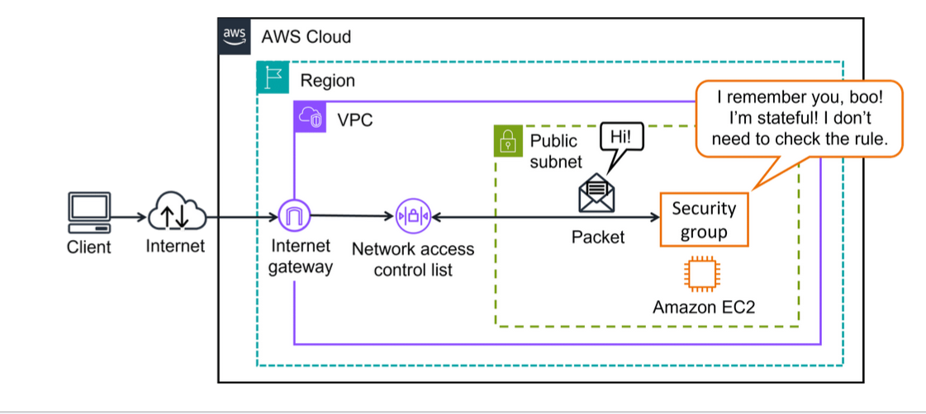

Slide 57
With both network ACLs and security groups, you can configure custom rules for the traffic in your VPC.
As you continue to learn more about AWS security and networking, it is important to understand the differences between them.
The following table will help you understand which to use.
Feature | Security Groups | Network ACLs
Scope | Instance level (attached to EC2 instances) | Subnet level (associated with subnets)
State | Stateful (remembers state) | Stateless (doesn't remember state)
Rule types | Only allow type rules | Both allow and deny type rules
Return traffic | Return traffic is automatically allowed if inbound traffic is allowed | Return traffic must be implicitly allowed in both directions
Uses | Fine-grained control of traffic for individual EC2 instances | Broad control of traffic in and out of subnets

Slide 58
Remember the AWS Shared Responsibility Model?
When it comes to securing the subnets and resources in your VPC with network ACLs and security groups, that is your responsibility.
These components make up networking traffic protection and are critical defenses in protecting your applications IN the cloud.

Slide 59
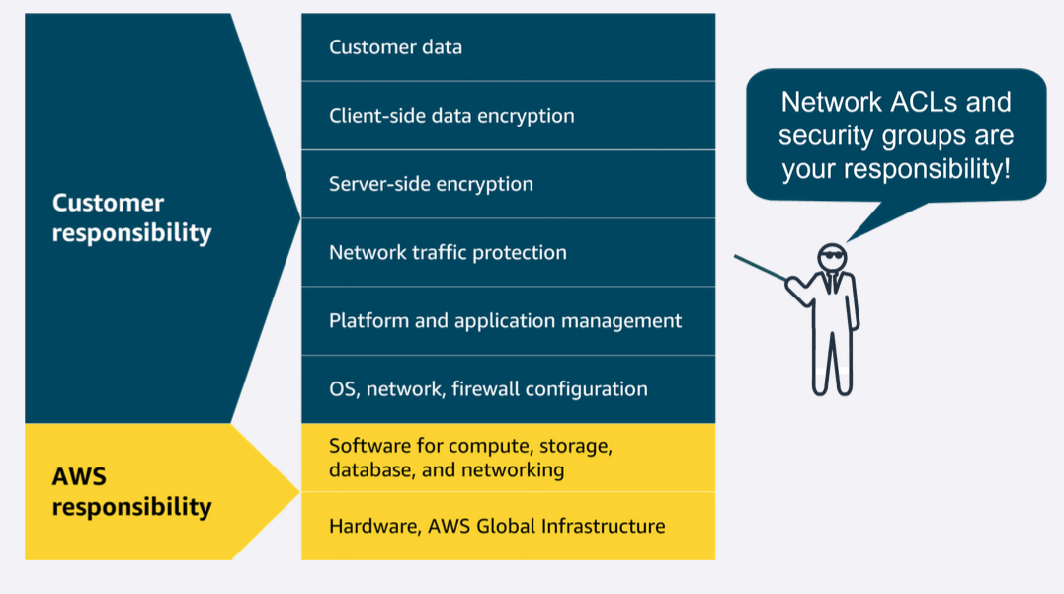
AWS Shared Responsibility Model

Slide 60
Amazon VPC Demo

Slide 61
In this lesson, you will learn:
Navigate in the AWS Management Console.
Review the steps to create a VPC.
Create both public and private subnets.
Create and attach an internet gateway.
Create a route table, add routes, and associate public subnets.

Slide 62
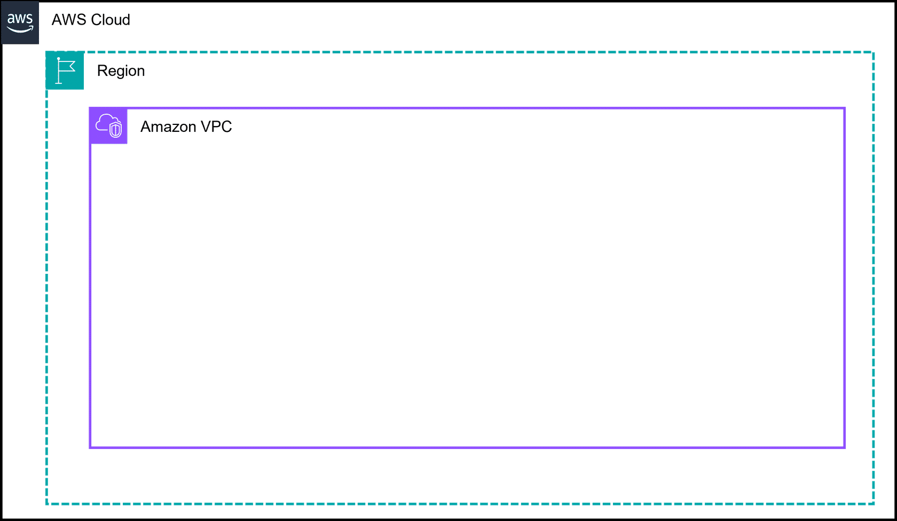
Building an Amazon VPC in the AWS Cloud
Core components covered in this demonstration
Create the Amazon VPC
Before you can create resources in the AWS Cloud, the first step is to create your own Amazon VPC. You will also specify the Region best located for your resources.

Slide 63
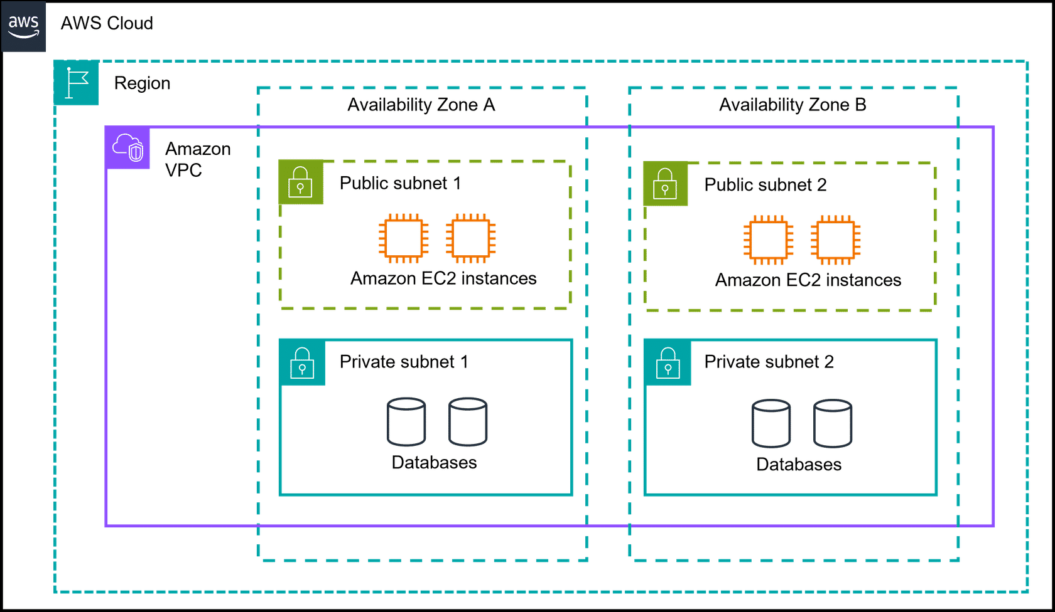
Building an Amazon VPC in the AWS Cloud
Create the subnets
You will create two public and private subnets across two availability zones. This is a best practice to achieve high availability.

Slide 64
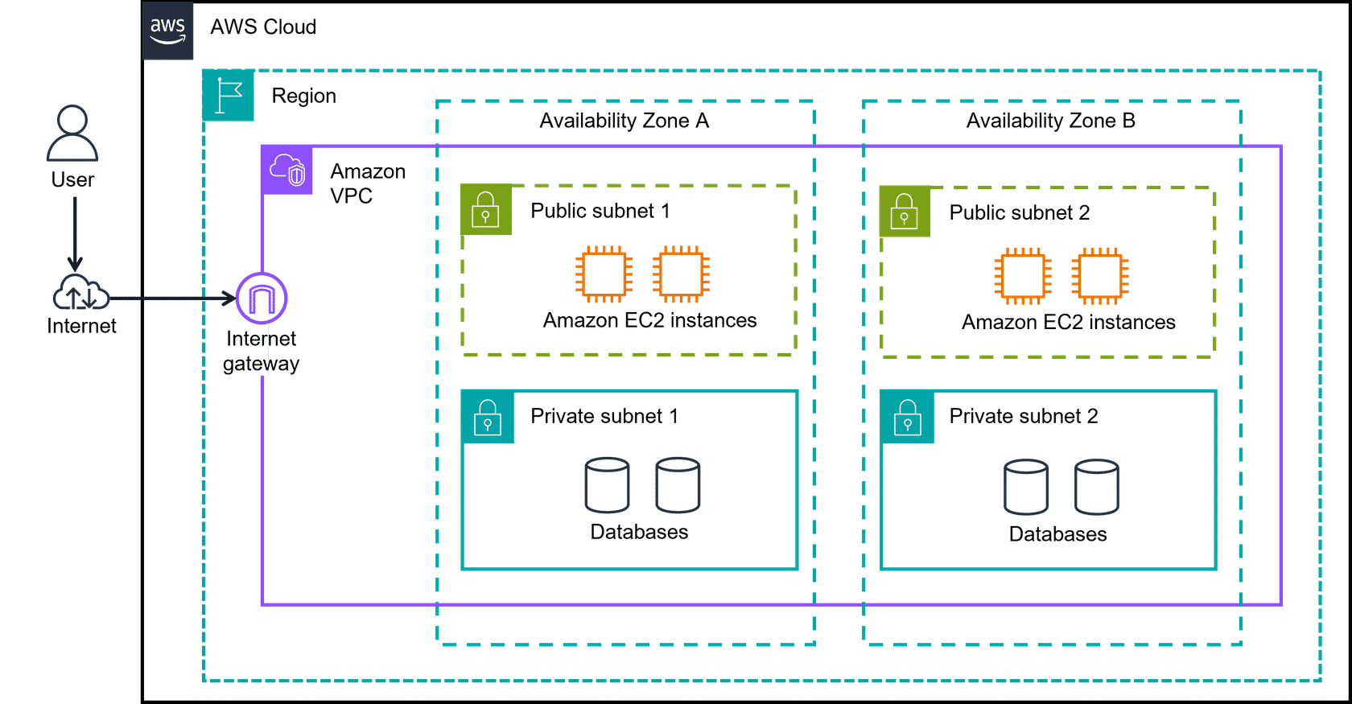
Create an internet gateway and route traffic
Without an internet gateway, your users can't get to your resources.
First, you create the internet gateway. Then, you create route tables to route traffic to allow internet traffic in and local traffic out.

Slide 65
Global Networking

Slide 66
In this lesson, you will learn:
Define what Domain Name System (DNS) is and what it does.
Describe benefits and use cases of Amazon Route 53.
Describe benefits and use cases of Amazon CloudFront.

Slide 67
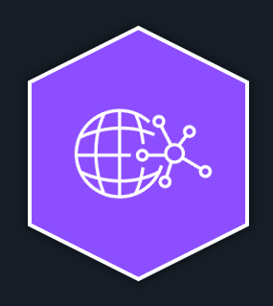
Global networking
You touched on Edge Locations briefly in an earlier lesson.
Now you will explore three Edge networking services in more detail.
You will identify what edge networking is, why it's important, and learn three AWS Edge services.
You will cover what they do, the benefits, and how some of them work together.

Slide 68
Edge networking services
Secure and speedy networking for user-facing application data
Edge networking is the process of bringing information storage and computing abilities closer to the devices that produce that information and the users who consume it.
Edge computing is important because organizations often need lower latency access to their data and content.
By performing tasks or caching data locally or closer to users, organizations can deliver faster, more responsive experiences while maintaining better control over their infrastructure.
There are also many different services that are hosted on the edge, like the DNS service, Amazon Route 53.

Slide 69
Translating domain names to IP addresses with DNS
Suppose that AnyCompany has a website hosted in the AWS Cloud.
Customers enter the web address into their browser and they are able to access the website.
This happens because of DNS resolution.
DNS resolution involves a customer DNS resolver communicating with a company DNS server.
You can think of DNS as being the phone book of the internet.
DNS resolution is the process of translating a domain name to an IP address.

Slide 70
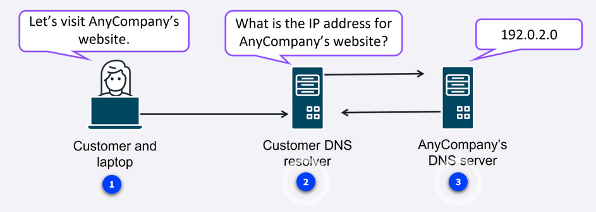
DNS
Customer and laptop
When you enter the domain name into your browser, this request is sent to a customer DNS resolver.
Customer DNS resolver
The customer DNS resolver asks the company DNS server for the IP address that corresponds to AnyCompany’s website.
AnyCompany's DNS server
The AnyCompany DNS server responds by providing the IP address for AnyCompany’s website, 192.0.2.0.

Slide 71
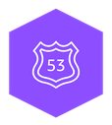
Amazon Route 53
Route 53 is a DNS that provides a reliable and cost-effective way to route end users to internet applications.
Route 53 directs end users to your resources with globally dispersed DNS servers and automatic scaling.
It gives developers and businesses a reliable way to route end users to internet applications hosted in AWS.
It connects user requests to infrastructure running in AWS, such as Amazon EC2 instances and load balancers.
It also routes users to infrastructure outside of AWS.
Another feature of Route 53 is the ability to manage the DNS records for domain names.
You can register new domain names directly in Route 53.
You can also transfer DNS records for existing domain names managed by other domain registrars.
This makes it possible for you to manage all of your domain names within a single location.
Route 53 also works with the next AWS edge networking service, Amazon CloudFront.

Slide 72
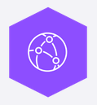
Amazon CloudFront
CloudFront is a content delivery network (CDN) service that delivers your content with fast
CloudFront is like a global network of delivery trucks that quickly brings web content to users around the world.
Instead of all requests traveling back to one central warehouse (your original server), CloudFront stores copies of your content at locations closer to your users.
This means websites, videos, images, and applications load much faster, no matter where your customers are located.

Slide 73
Three categories of Amazon CloudFront
Streaming video service
A company that offers online workout videos uses CloudFront to make sure videos play smoothly without buffering, even during peak exercise times when thousands of users log in simultaneously.
Ecommerce website
An online store uses CloudFront to deliver product images and web pages quickly during busy shopping seasons.
This faster experience keeps customers engaged and reduces abandoned shopping carts.
Mobile App
A travel app uses CloudFront to deliver map data and images to users' phones quickly to help travelers navigate new cities without frustrating delays.

Slide 74
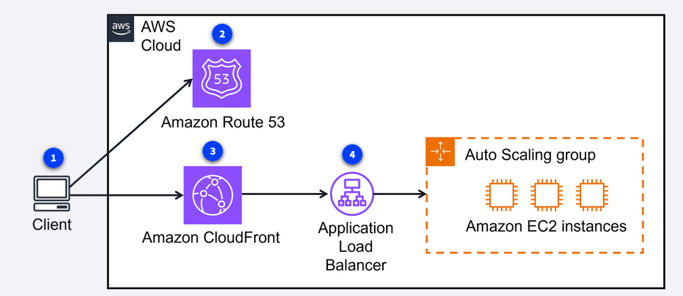
Now that you know a little more about CloudFront, here is an example of how it can work for customer requests.
The following example describes how Route 53 and CloudFront work together to deliver content to customers.

Slide 75
Customer request
A customer requests data from the application by going to AnyCompany’s website.
Amazon Route 53
Amazon Route 53 uses DNS resolution to identify AnyCompany.com’s corresponding IP address, 192.0.2.0.
This information is sent back to the customer.
CloudFront
The customer’s request is sent to the nearest edge location through CloudFront.
Application Load Balancer
Amazon CloudFront connects to the Application Load Balancer, which sends the incoming packet to an Amazon EC2 instance.

Slide 76
AWS Global Accelerator
Global Accelerator is a service that uses the AWS global network to improve application availability, performance, and security.
It uses intelligent traffic routing and fast failover if something goes wrong in one of your application locations.
Global Accelerator is a networking service that helps your applications run faster and more reliably across the globe.
Think of it like creating express lanes on the internet highway specifically for your application's traffic.
Instead of your users' requests taking the regular, sometimes congested internet routes, Global Accelerator directs traffic through the AWS private global network—getting your users to your application faster and more reliably.

Slide 77
Use cases for AWS Global Accelerator
Global gaming company
A gaming company uses Global Accelerator to reduce lag and provide smoother gameplay for players around the world.
Players in Tokyo, New York, and London all experience similar, responsive gameplay because their connections are optimized.
Financial services application
A banking app uses Global Accelerator to ensure their customers always have fast, reliable access to their accounts.
Even during peak times or when network conditions in one area are poor, customers can check balances and make transactions without frustrating delays.

Slide 78
In brief
Several AWS edge services are similar and are used in global networking solutions.
To review these AWS edge services:
Amazon Route 53 Route 53 is a highly available and scalable cloud DNS service.
Amazon CloudFront CloudFront is a CDN service that delivers your content with low latency and high speeds.
AWS Global Accelerator Global Accelerator is a service that uses the AWS global network to improve application availability, performance, and security.

Slide 79
Global Architectures

Slide 80
In this lesson, you will learn:
Identify examples of when to use a VPN or Direct Connect.
Describe at a high level how a VPC with a virtual private network (VPN) connection and Direct Connect work together.
Describe how a multi-Region architecture works with CloudFront and Route53.

Slide 81
AWS Networking – Scaling Beyond a Single VPC
1. VPC with VPN Connection
What it is:
A Virtual Private Network (VPN) connection securely links your on-premises network to your AWS VPC.
Uses the public internet, but the tunnel is encrypted for data security.
Use cases:
Remote employees securely accessing AWS resources.
Companies wanting to extend their private networks into AWS.
Limitations:
Dependent on public internet bandwidth (can slow down under heavy load).
May not meet all compliance or high-performance requirements.

Slide 82
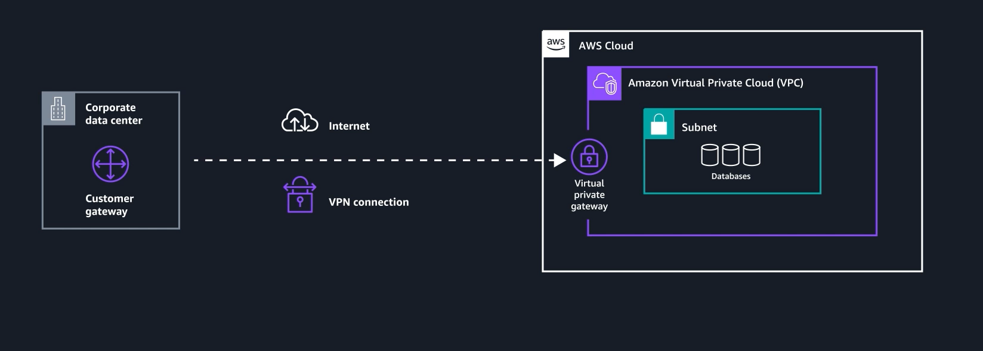

Slide 83
2. AWS Direct Connect
What it is:
A dedicated, private fiber connection from your on-premises data center to AWS.
Bypasses the public internet.
Benefits:
High bandwidth, low latency, consistent performance.
Increased security and regulatory compliance.
Ideal for large data transfers and mission-critical workloads.

Slide 84
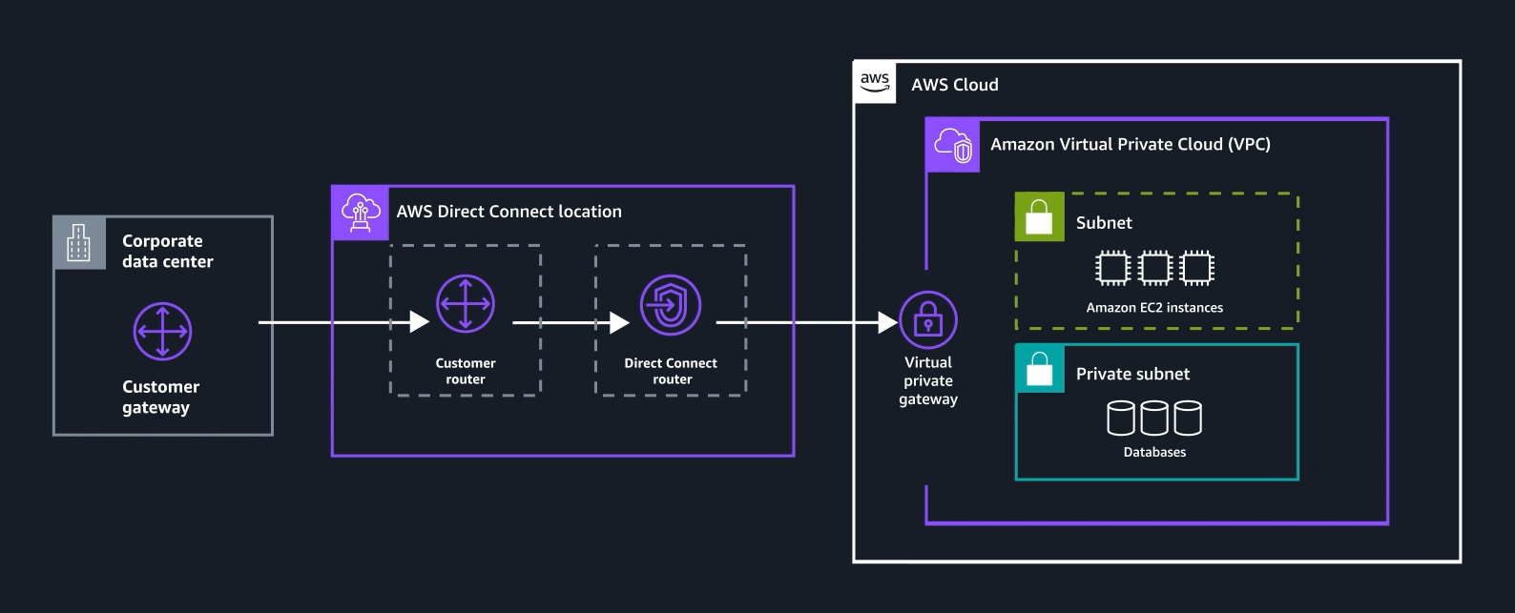

Slide 85
3. VPN vs Direct Connect
Use VPN when:
You need secure, flexible, and cost-effective remote access.
Data transfer needs are small to medium.
Use Direct Connect when:
You need high bandwidth and reliable performance.
You’re moving large datasets or hosting latency-sensitive apps.
Use both together when:
You want VPN as a backup (failover) for Direct Connect.
You want increased fault tolerance (multiple lines).
You want aggregate bandwidth (combine multiple connections).

Slide 86
4. Global Content Delivery (Multi-Region Setup)
For companies serving users worldwide:
Amazon Route 53 (DNS + Routing):
Directs users to the closest AWS region using policies like latency-based routing.
Amazon CloudFront (CDN):
Distributes cached content via edge locations near customers.
Reduces latency and improves user experience.
Multi-VPC & Multi-Region:
Applications are deployed across multiple AWS Regions.
Users are routed automatically to the nearest, fastest region.

Slide 87
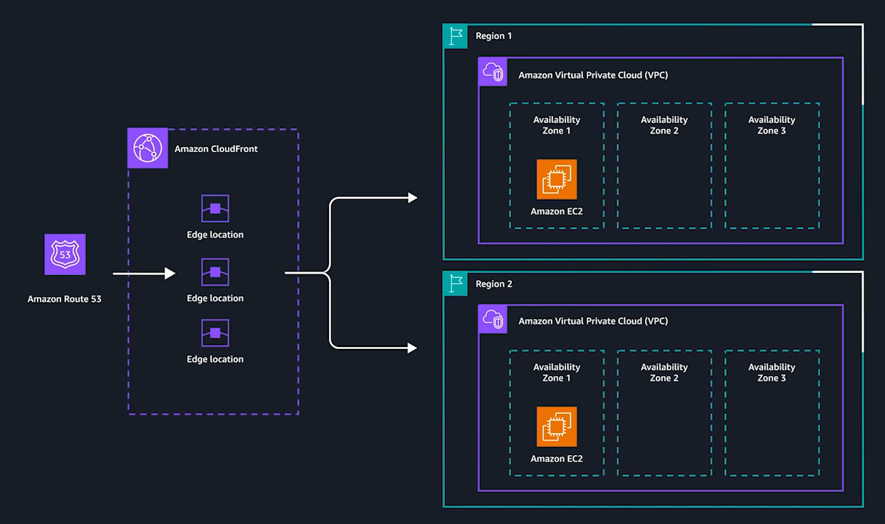

Slide 88
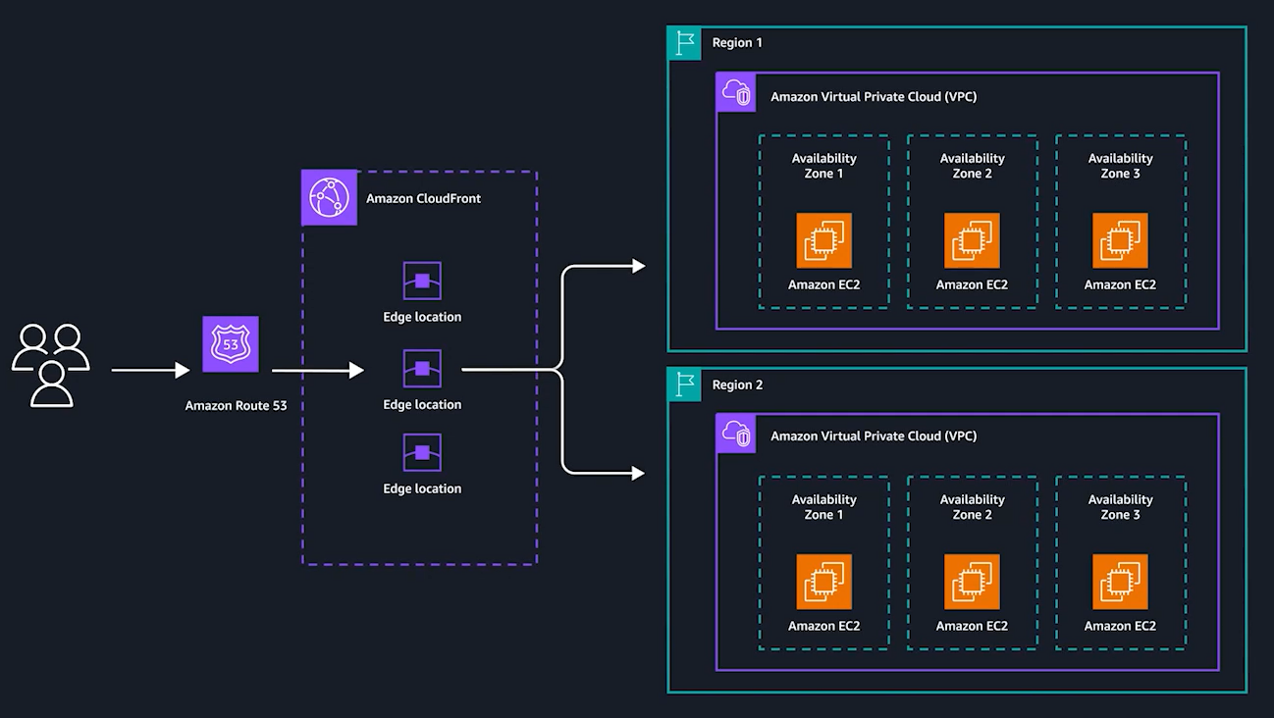

Slide 89
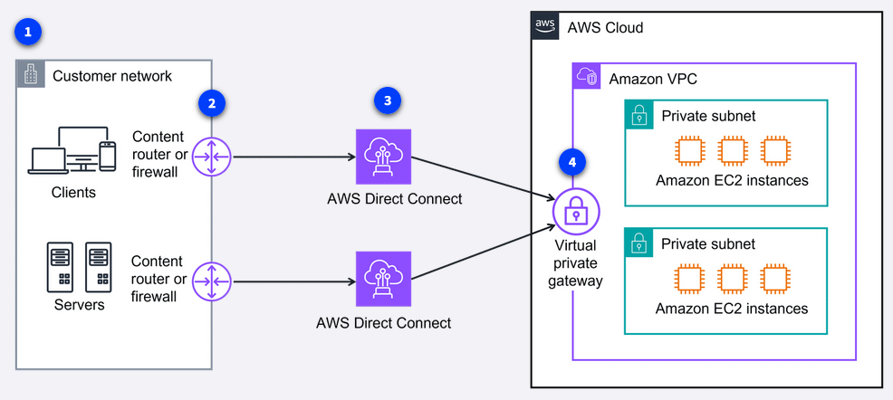
Cloud in real life: Exploring the examples
Customer network
The customer network clients and servers need a secure, high-bandwidth connection for large data transfers and critical application performance.
Content router or firewall
The customer has a content router or firewall connecting their network to Direct Connect.
Multiple Direct Connect connections
In addition to fault tolerance,
the customer wanted increased
bandwidth. They can even combine
multiple connections to achieve
higher aggregate bandwidth.
Virtual private gateway
Using a virtual private gateway,
the clients can securely access the
private resources in the Amazon VPC.

Slide 90
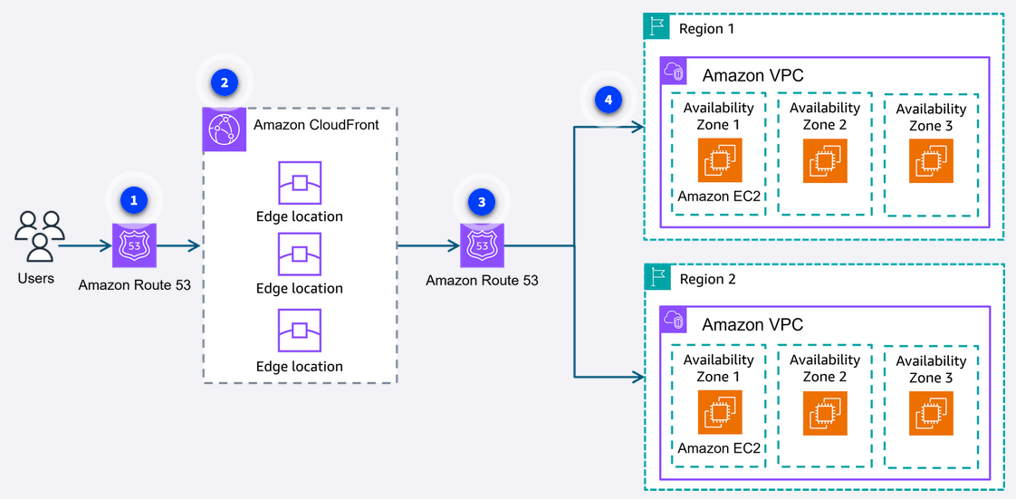
Delivering content to several different Regions globally
Here is an example of how a company with offices around the world can deliver content with low latency for a seamless experience across multiple Regions.

Slide 91
Users
The users access the company's website using a custom domain.
The request is first sent to a Route 53 DNS record.
Routing policy
Route 53 uses a routing policy to determine which Region is closest to the user.
Route 53 directs the user to the appropriate CloudFront edge location.
Direct to edge locations
Route 53 directs the user to the CloudFront edge location in the appropriate Region.
Content in multiple AZs
The content is fetched from the designated origin server in the chosen Region.
Also note, the website was built with resources in multiple Availability Zones for high availability.

Slide 92
Recap
In this networking module, you identified core networking components and how they connect in the AWS Cloud.
We covered the basics of a VPC, the way that you isolate your workload in AWS, gateways, network ACLs, and security groups.
You also reviewed ways to connect to AWS through a VPN and Direct Connect, secure connections that are either encrypted over the public internet or exclusive connections used by you and you alone.
You also learned about AWS edge locations, Route 53 for DNS, and CloudFront to cache content closer to consumers.

Slide 93
Resources
Resource link | Description
Amazon Virtual Private Cloud | Amazon VPC is a service to provision a logically isolated section of the AWS Cloud where you can launch AWS resources in a virtual network that you define.
Subnet | A subnet is a section of a VPC that can contain resources and is used to organize your resources. They can contain be either public or private.
Internet gateway | An internet gateway is a connection between a VPC and the internet. It allows public traffic from the internet to access your VPC.
Virtual private gateway | A virtual private gateway is the component that allows protected internet traffic to enter into the VPC. It allows a connection between your VPC and a private network only if it is coming from an approved network.
AWS Client VPN | Amazon Client VPC is a networking service you can use to connect your remote workers and on-premises networks to the cloud. It is a fully managed, elastic VPN service that automatically scales up or down based on user demand.
AWS Site-to-Site VPN | AWS Site-to-Site VPN creates a secure connection between your data center or branch offices and your AWS Cloud resources.
AWS PrivateLink | AWS PrivateLink is a highly available, scalable technology that you can use to privately connect your VPC to services and resources as though they were in your VPC.
AWS Direct Connect | AWS Direct Connect is a service that provides a dedicated private connection between your data center and a VPC.
Network Access Control List (network ACL) | A network ACL allows or denies specific inbound or outbound traffic at the subnet level using stateless packet filtering.
Security groups | Security groups control the inbound and outbound traffic for a resource at the instance level using stateful packet filtering.
Domain Name System (DNS) | DNS translates human readable domain names to machine readable IP addresses (for example, 192.0.2.0).
Amazon Route 53 | Route 53 is a scalable and reliable DNS web service that helps developers and businesses route end users to internet applications, whether they’re hosted in AWS or elsewhere. It also supports domain registration, health checks, and advanced traffic routing policies.
Amazon CloudFront | CloudFront is a web service that speeds up distribution of your web content to your users through a worldwide network of data centers called edge locations. It securely delivers content with low latency and high transfer speeds.
AWS Global Accelerator | Global Accelerator is a networking service that helps improve the availability and performance of applications for global users by routing traffic through the AWS global network. It helps improve application availability, performance, and security.
Amazon Transit Gateway | Amazon VPC Transit Gateways is a network transit hub used to interconnect VPCs and on-premises networks.
NAT Gateway | Network Address Translation (NAT) gateway allows instances in a private subnet to connect with services outside your VPC. External services can't initiate a connection with those instances.
API Gateway | The Amazon API Gateway is an AWS service for creating, publishing, maintaining, monitoring, and securing APIs at any scale. It handles all the tasks involved in accepting and processing up to hundreds of thousands of concurrent API calls.

